Slide 1
The Physical Work Environment
Sections:
The Visual Environment and Lighting
The Auditory Environment and Noise
Climate Control in the Work Environment
Work Systems and the Methods, Measurement, and Management of Work
by Mikell P. Groover. ISBN 0-13-140650-7
©2007 Pearson Education, Inc., Upper Saddle River, N.J. All rights reserved.

Slide 2
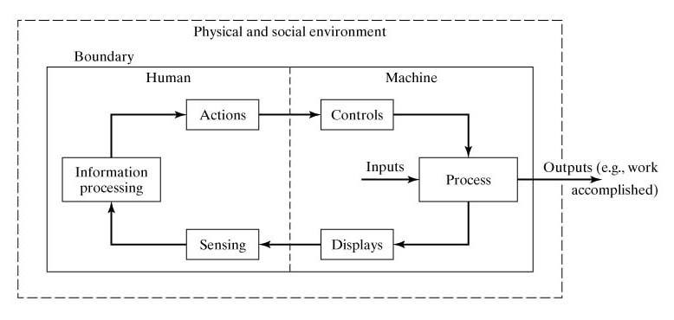
Human-Machine Interactions
Work Systems and the Methods, Measurement, and Management of Work
by Mikell P. Groover. ISBN 0-13-140650-7
©2007 Pearson Education, Inc., Upper Saddle River, N.J. All rights reserved.

Slide 3
Visual Environment and Lighting
About 80% of the information input to the human brain comes from visual stimuli
Topics:
  The physics of light
  Visibility
  Lighting systems
Work Systems and the Methods, Measurement, and Management of Work
by Mikell P. Groover. ISBN 0-13-140650-7
©2007 Pearson Education, Inc., Upper Saddle River, N.J. All rights reserved.

Slide 4
The Physics of Light
Light - electromagnetic radiant energy within the visible spectrum between ultraviolet and infrared.
Photometry – branch of optical physics concerned with the measurement of light
Photometer - an instrument that measures light
Our interest: provide proper levels of lighting and contrasts among objects in a workplace.
Work Systems and the Methods, Measurement, and Management of Work
by Mikell P. Groover. ISBN 0-13-140650-7
©2007 Pearson Education, Inc., Upper Saddle River, N.J. All rights reserved.

Slide 5
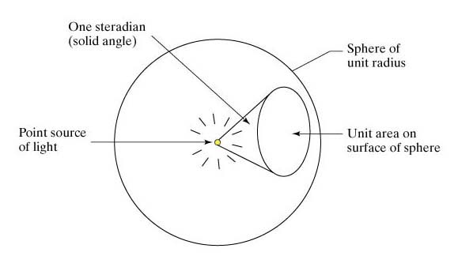
Point Source of Light
Unit circle
1 rad.
1 candela = 1 lumen per one steradian
Arc of unit length
Work Systems and the Methods, Measurement, and Management of Work
by Mikell P. Groover. ISBN 0-13-140650-7
©2007 Pearson Education, Inc., Upper Saddle River, N.J. All rights reserved.

Slide 6
The Physics of Light
Illuminance - luminous flux shining per unit area on a surface
  Units: lux (lx) = 1 lumen per sq meter
Luminance - amount of light reflected from a surface
  Units: cd/sq m
  Depends on
    Illuminance - amount of light striking surface
    Reflectance - depends on color and texture of surface
Work Systems and the Methods, Measurement, and Management of Work
by Mikell P. Groover. ISBN 0-13-140650-7
©2007 Pearson Education, Inc., Upper Saddle River, N.J. All rights reserved.

Slide 7
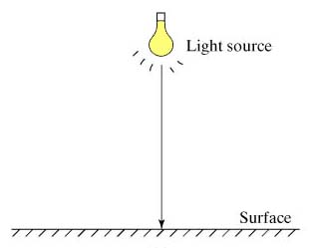
Angle of Incidence θ = 0
Illuminance decreases with distance from light source
E = I / d²
where
E = illuminance,
I = luminous intensity, d = distance
Work Systems and the Methods, Measurement, and Management of Work
by Mikell P. Groover. ISBN 0-13-140650-7
©2007 Pearson Education, Inc., Upper Saddle River, N.J. All rights reserved.

Slide 8
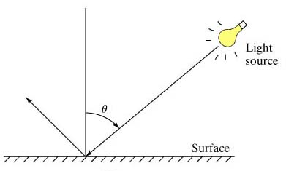
Incident Light is at Angle θ
E = I cos θ / d²
Work Systems and the Methods, Measurement, and Management of Work
by Mikell P. Groover. ISBN 0-13-140650-7
©2007 Pearson Education, Inc., Upper Saddle River, N.J. All rights reserved.

Slide 9
Reflectance (skip)
R=πL/E
where
R=reflectance (a fraction);
L=luminance, cd/sq m;
E=illuminance, lx
So L = RE/π
Work Systems and the Methods, Measurement, and Management of Work
by Mikell P. Groover. ISBN 0-13-140650-7
©2007 Pearson Education, Inc., Upper Saddle River, N.J. All rights reserved.

Slide 10
Typical Reflectance Values
Object Reflectance
Mirrored glass 0.80 - 0.90
White matte paint 0.75 - 0.90
Aluminum paint 0.60 - 0.70
Black painted object 0.03 - 0.05
Color Reflectance
White 0.85
Light green 0.65
Medium blue 0.35
Dark blue 0.08
Work Systems and the Methods, Measurement, and Management of Work
by Mikell P. Groover. ISBN 0-13-140650-7
©2007 Pearson Education, Inc., Upper Saddle River, N.J. All rights reserved.

Slide 11
Visibility
Relative possibility of being seen under prevailing conditions of light, distance, and related factors
Most important factor = level of illumination
Other factors:
  Visual angle - angle subtended at the eye by the smallest distinguishable detail
    α_{v} = 3438 h/d
  where α_{v} is measured in arc minutes
    Increase the size of the object (increase h) or bring it closer (decrease d)
  Brightness contrast - relative luminance between object and background
    Light object against a dark background or the opposite
  Color
    Red: danger, Yellow: caution, Green: safety
Work Systems and the Methods, Measurement, and Management of Work
by Mikell P. Groover. ISBN 0-13-140650-7
©2007 Pearson Education, Inc., Upper Saddle River, N.J. All rights reserved.

Slide 12
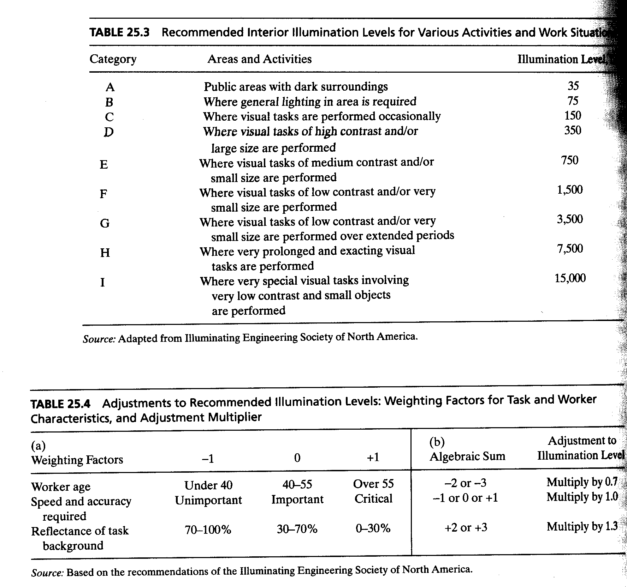
Illumination
Levels
Work Systems and the Methods, Measurement, and Management of Work
by Mikell P. Groover. ISBN 0-13-140650-7
©2007 Pearson Education, Inc., Upper Saddle River, N.J. All rights reserved.

Slide 13
Illumination Levels
Illuminance | Example
10⁻⁴ lux | Total starlight, overcast sky^{[2]}
0.002 lux | Moonless clear night sky with airglow^{[2]}
0.01 lux | Quarter moon
0.27 lux | Full moon on a clear night^{[2][3]}
1 lux | Full moon overhead at tropical latitudes^{[4]}
3.4 lux | Dark limit of civil twilight under a clear sky^{[5]}
50 lux | Family living room^{[6]}
80 lux | Hallway/toilet^{[7][8]}
100 lux | Very dark overcast day^{[2]}
320–500 lux | Office lighting^{[9][10][11]}
400 lux | Sunrise or sunset on a clear day.
1,000 lux | Overcast day^{[2]}; typical TV studio lighting
10,000–25,000 lux | Full daylight (not direct sun)^{[2]}
32,000–130,000 lux | Direct sunlight
Work Systems and the Methods, Measurement, and Management of Work
by Mikell P. Groover. ISBN 0-13-140650-7
©2007 Pearson Education, Inc., Upper Saddle River, N.J. All rights reserved.

Slide 14
Recommended Illumination Level
Given: A workplace has a reflactance of only 25% for a task that is performed by a 45-year old female worker. The task includes visual elements involving small objects. Speed and accuracy requirements are judged to be critical.
Determine: What is the recommended illumination level?
Solution:
Work best fits into category E, that is illumination level is 750 lx
Age correction:0
Speed and accuracy requirement:+1
Reflectance: +1
Total:+2
Then the recommended illumination level is 750*1.3=975 lx.
Work Systems and the Methods, Measurement, and Management of Work
by Mikell P. Groover. ISBN 0-13-140650-7
©2007 Pearson Education, Inc., Upper Saddle River, N.J. All rights reserved.

Slide 15
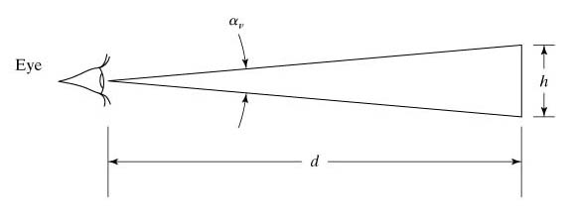
Visual Angle
  Visual angle - angle subtended at the eye by the smallest distinguishable detail
    α_{v} = 3438 h/d
  where α_{v} is measured in arc minutes
Work Systems and the Methods, Measurement, and Management of Work
by Mikell P. Groover. ISBN 0-13-140650-7
©2007 Pearson Education, Inc., Upper Saddle River, N.J. All rights reserved.

Slide 16
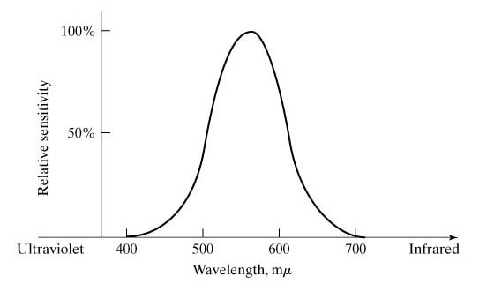
Color Sensitivity of Human Eye
Work Systems and the Methods, Measurement, and Management of Work
by Mikell P. Groover. ISBN 0-13-140650-7
©2007 Pearson Education, Inc., Upper Saddle River, N.J. All rights reserved.

Slide 17
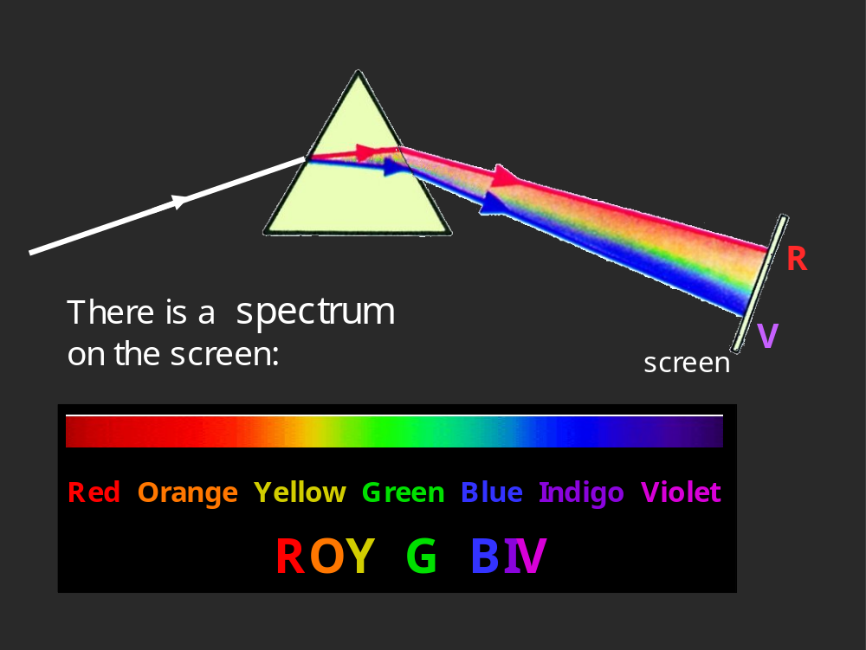
Color
Work Systems and the Methods, Measurement, and Management of Work
by Mikell P. Groover. ISBN 0-13-140650-7
©2007 Pearson Education, Inc., Upper Saddle River, N.J. All rights reserved.

Slide 18
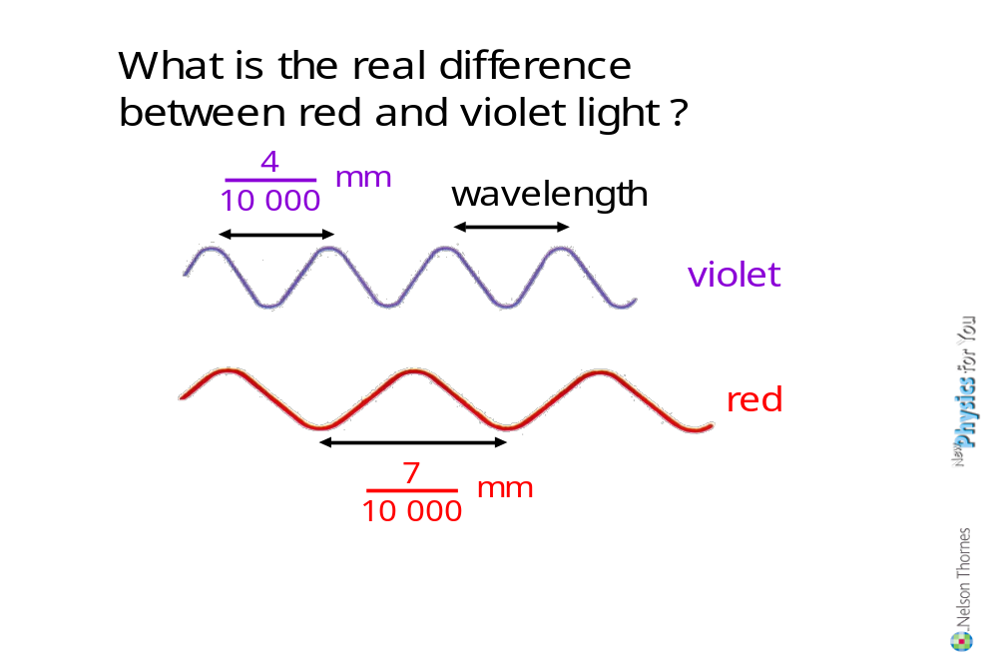
Color
Work Systems and the Methods, Measurement, and Management of Work
by Mikell P. Groover. ISBN 0-13-140650-7
©2007 Pearson Education, Inc., Upper Saddle River, N.J. All rights reserved.

Slide 19
Lighting Systems
Lamp - a single artificial source of light (e.g., an incandescent lamp)
Luminaire - complete lighting unit, including
  One or more lamps
  Reflectors and other apparatus to distribute the light
  Means to connect to power supply
Work Systems and the Methods, Measurement, and Management of Work
by Mikell P. Groover. ISBN 0-13-140650-7
©2007 Pearson Education, Inc., Upper Saddle River, N.J. All rights reserved.

Slide 20
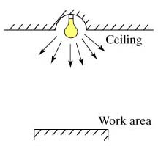
Types of Luminaires
Direct lighting
Work Systems and the Methods, Measurement, and Management of Work
by Mikell P. Groover. ISBN 0-13-140650-7
©2007 Pearson Education, Inc., Upper Saddle River, N.J. All rights reserved.

Slide 21
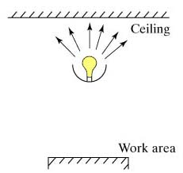
Types of Luminaires
Indirect lighting
Work Systems and the Methods, Measurement, and Management of Work
by Mikell P. Groover. ISBN 0-13-140650-7
©2007 Pearson Education, Inc., Upper Saddle River, N.J. All rights reserved.

Slide 22
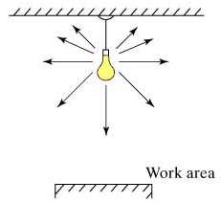
Types of Luminaires
Combination of direct and indirect lighting
Work Systems and the Methods, Measurement, and Management of Work
by Mikell P. Groover. ISBN 0-13-140650-7
©2007 Pearson Education, Inc., Upper Saddle River, N.J. All rights reserved.

Slide 23
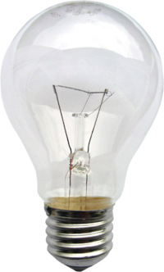
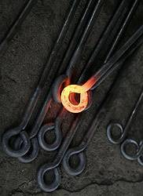
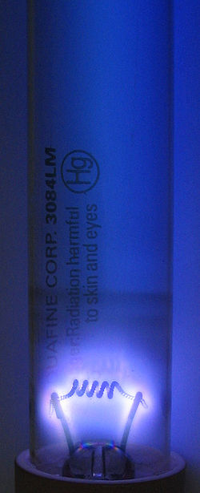
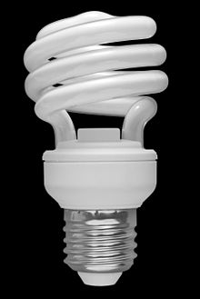
Two Basic Types of Lamps
Incandescent lamps - electrically heating a filament that produces radiant energy, some of which is in the visible spectrum
  Common filament material - tungsten
Discharge lamps - produce light by means of an electric discharge in a gas (mercury, sodium)
  Common discharge lamp - fluorescent lamp, which contains mercury vapor that emits light when bombarded by electrons
Work Systems and the Methods, Measurement, and Management of Work
by Mikell P. Groover. ISBN 0-13-140650-7
©2007 Pearson Education, Inc., Upper Saddle River, N.J. All rights reserved.

Slide 24
Characteristics of Lamps
Lamp life
Luminous efficacy: capacity to convert electrical power into luminous power
Color rendering: capability to illuminate objects in their true colors
  Measured in terms of color rendering index (CRI) score
    Highest score = 100% (daylight)
Work Systems and the Methods, Measurement, and Management of Work
by Mikell P. Groover. ISBN 0-13-140650-7
©2007 Pearson Education, Inc., Upper Saddle River, N.J. All rights reserved.

Slide 25
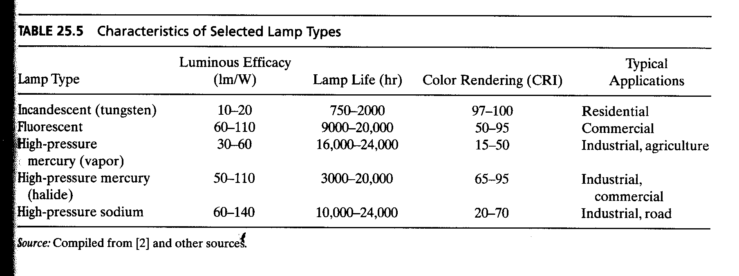
Tradeoff between luminuous efficacy and color rendering
Work Systems and the Methods, Measurement, and Management of Work
by Mikell P. Groover. ISBN 0-13-140650-7
©2007 Pearson Education, Inc., Upper Saddle River, N.J. All rights reserved.

Slide 26
Auditory Environment and Noise
The second most important means by which humans receive information
Visual and auditory stimuli account for 95% or more of a person's information input
The auditory environment also includes:
  Noise - defined as unwanted sound
Work Systems and the Methods, Measurement, and Management of Work
by Mikell P. Groover. ISBN 0-13-140650-7
©2007 Pearson Education, Inc., Upper Saddle River, N.J. All rights reserved.

Slide 27
Effects of Noise on Humans
Distraction
Negative emotions such as annoyance, frustration, anger, and fear
Interference with conversation, thinking, and other cognitive processes
Interference with sleeping
Temporary hearing loss
Permanent hearing loss
Work Systems and the Methods, Measurement, and Management of Work
by Mikell P. Groover. ISBN 0-13-140650-7
©2007 Pearson Education, Inc., Upper Saddle River, N.J. All rights reserved.

Slide 28
Hearing
Process of perceiving sound
  The sensation is stimulated by acoustic waves - air pressure oscillations
A simple sound-generating source produces a pure tone, which is characterized by two physical attributes:
  Frequency (Hz) - perceived as pitch(perde)
  Intensity (dB) - perceived as loudness
Work Systems and the Methods, Measurement, and Management of Work
by Mikell P. Groover. ISBN 0-13-140650-7
©2007 Pearson Education, Inc., Upper Saddle River, N.J. All rights reserved.

Slide 29
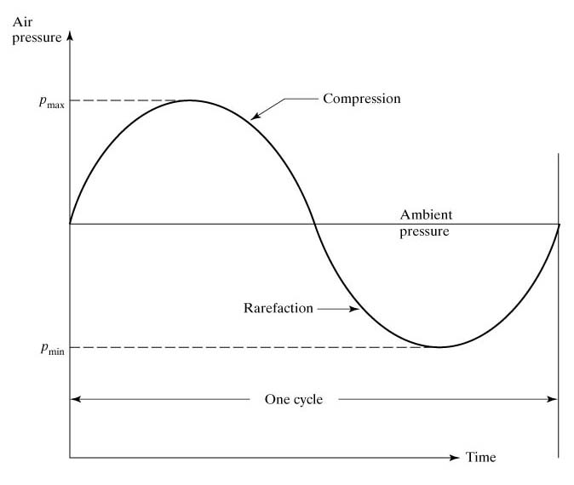
Sound: A Pure Tone (skip)
Sinusoidal pressure oscillations of a simple sound-generating source
intensity
For the effective sound pressure, the squares of the compression and the rarefaction pressures of a wave are averaged (root-mean-square technique).
Work Systems and the Methods, Measurement, and Management of Work
by Mikell P. Groover. ISBN 0-13-140650-7
©2007 Pearson Education, Inc., Upper Saddle River, N.J. All rights reserved.

Slide 30
Sound Intensity
Measured as pressure, e.g., N/m² or Pa
However, range of sound pressures is very large (0.00002 N/m² to 20 N/m²)
Thus, intensity is converted to logarithmic scale, called sound pressure level (SPL) with units of decibel (dB):
SPL = 20 log₁₀(p_{s} / p_{r})
where
p_{s} = sound pressure from source, N/m² ,
p_{r} = reference sound pressure, N/m² (the usual reference pressure is 0.00002 N/m²)
Work Systems and the Methods, Measurement, and Management of Work
by Mikell P. Groover. ISBN 0-13-140650-7
©2007 Pearson Education, Inc., Upper Saddle River, N.J. All rights reserved.

Slide 31
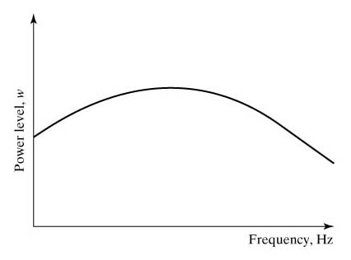
Power Spectrum of a Sound
Continuous power spectrum of a sound consisting of multiple frequencies
Intensity of a sound diminishes by the distance
Work Systems and the Methods, Measurement, and Management of Work
by Mikell P. Groover. ISBN 0-13-140650-7
©2007 Pearson Education, Inc., Upper Saddle River, N.J. All rights reserved.

Slide 32
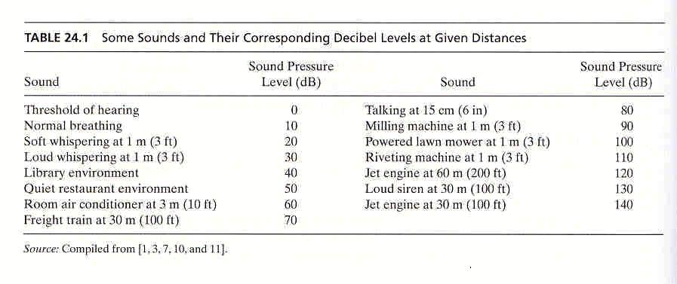
Work Systems and the Methods, Measurement, and Management of Work
by Mikell P. Groover. ISBN 0-13-140650-7
©2007 Pearson Education, Inc., Upper Saddle River, N.J. All rights reserved.

Slide 33
Noise Factors of Primary Concern
Two noise factors of primary concern in terms of their effects on human workers:
  Intensity of the noise
    Perceived by listener as loudness
  Duration of exposure
Work Systems and the Methods, Measurement, and Management of Work
by Mikell P. Groover. ISBN 0-13-140650-7
©2007 Pearson Education, Inc., Upper Saddle River, N.J. All rights reserved.

Slide 34
Other Noise Factors of Interest
Frequency
  Perceived by listener as pitch
  Industrial noise is usually broadband - composed of a wide range of frequencies so its importance is diminished
Noncontinuous noise
  Intermittent noise - machines with on-off cycle
  Impact noise - drop forge hammer
  Impulse noise – gunfire
Work Systems and the Methods, Measurement, and Management of Work
by Mikell P. Groover. ISBN 0-13-140650-7
©2007 Pearson Education, Inc., Upper Saddle River, N.J. All rights reserved.

Slide 35
Physiological Effects of Noise
Startle response - due to sudden loud noise
  Causes spontaneous muscle contractions, blinking eyes
Hearing loss (three categories):
  Temporary threshold shift - hearing impairment of short duration
  Noise-induced permanent threshold shift - results from long term exposure to noise levels above 90 dB
  Acoustic trauma - single exposure to high intensity noise can cause temporary or permanent hearing loss
Work Systems and the Methods, Measurement, and Management of Work
by Mikell P. Groover. ISBN 0-13-140650-7
©2007 Pearson Education, Inc., Upper Saddle River, N.J. All rights reserved.

Slide 36
Permissible Noise Levels
Established by Occupational Safety and Health Administration (OSHA) to avoid hearing loss
Standards specify permissible duration of exposures for various dB levels
Sound Level Duration Sound Level Duration
80 dBA 32 hr 95 dBA 4 hr
85 dBA 16 hr 100 dBA 2 hr
90 dBA 8 hr 105 dBA 1 hr
92 dBA 6 hr 110 dBA 30 min
Work Systems and the Methods, Measurement, and Management of Work
by Mikell P. Groover. ISBN 0-13-140650-7
©2007 Pearson Education, Inc., Upper Saddle River, N.J. All rights reserved.

Slide 37
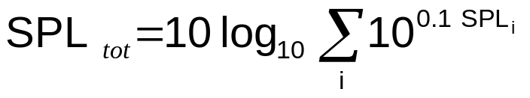
Multiple noise sources
Combined effect of multiple sources can be found by
where
SPL_{tot} = total sound pressure level of multiple noise sources, dBA;
SPL_{i} = sound pressure level of noise source i, dBA.
For example, two sources one at 87 dBA and the other at 89 dBA corresponds to a total sound pressure level of
higher than either taken individually.
Work Systems and the Methods, Measurement, and Management of Work
by Mikell P. Groover. ISBN 0-13-140650-7
©2007 Pearson Education, Inc., Upper Saddle River, N.J. All rights reserved.

Slide 38
Noise Control
Administrative controls
  Managing the exposure durations for employees working in noisy environments
    Setting time limits on exposure to noise level
Engineering controls
  Noise abatement at three locations:
    Source - design quieter machinery
    Receiver - use of ear plugs, helmets
    Path between source and receiver - enclosures for noisy machines
Work Systems and the Methods, Measurement, and Management of Work
by Mikell P. Groover. ISBN 0-13-140650-7
©2007 Pearson Education, Inc., Upper Saddle River, N.J. All rights reserved.

Slide 39

Source-Path-Receiver Model
The source-path-receiver viewpoint in the design of engineering controls for noise abatement
Three regions where noise can be reduced:
  at the source,
  at the receiver,
  along the path between source and receiver
Work Systems and the Methods, Measurement, and Management of Work
by Mikell P. Groover. ISBN 0-13-140650-7
©2007 Pearson Education, Inc., Upper Saddle River, N.J. All rights reserved.

Slide 40
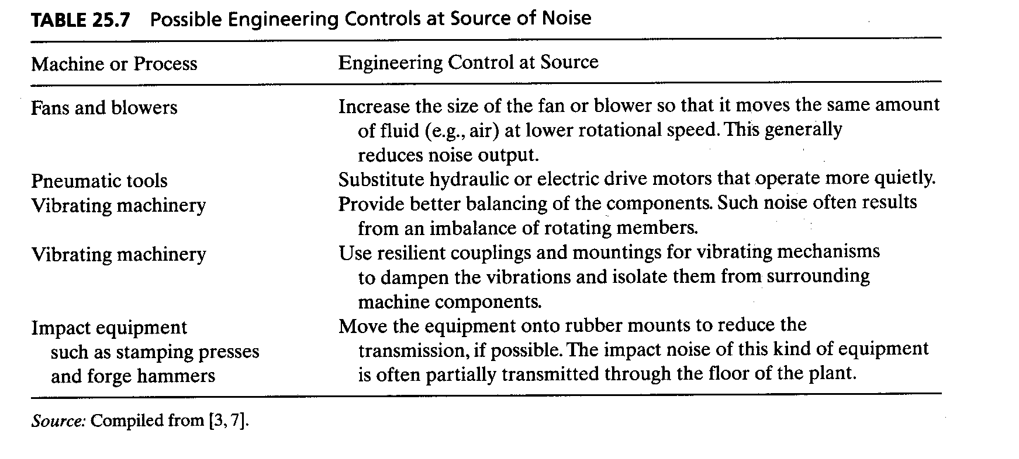
Work Systems and the Methods, Measurement, and Management of Work
by Mikell P. Groover. ISBN 0-13-140650-7
©2007 Pearson Education, Inc., Upper Saddle River, N.J. All rights reserved.

Slide 41
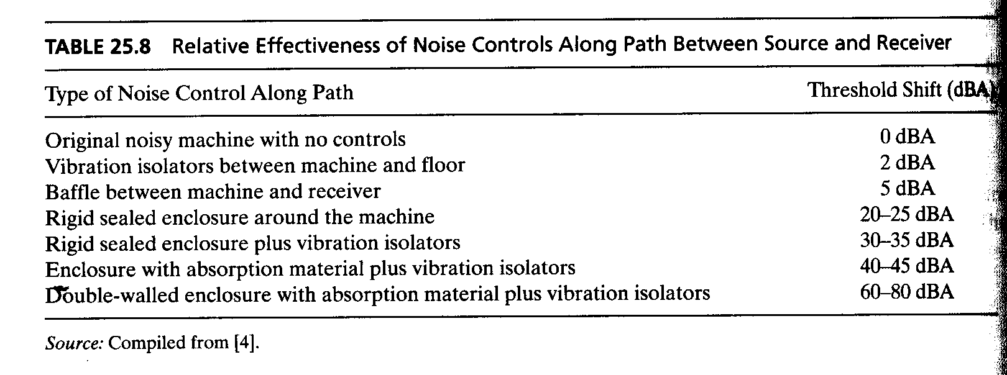
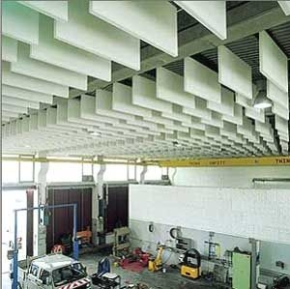
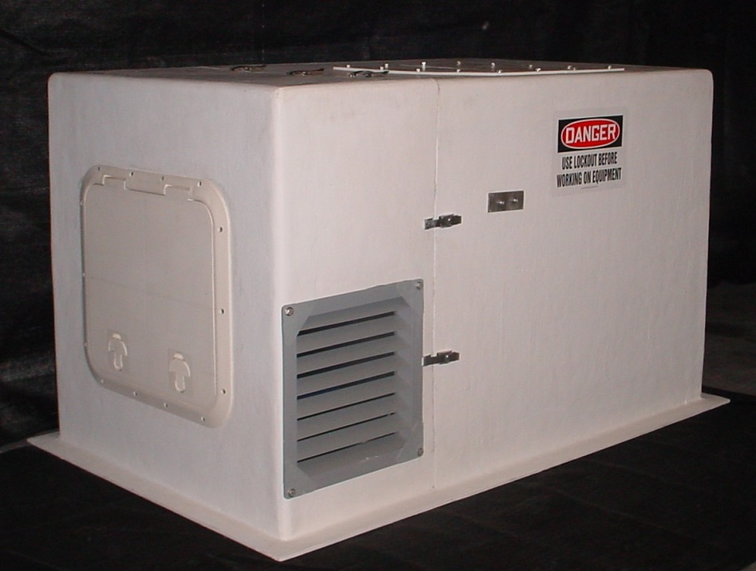
Work Systems and the Methods, Measurement, and Management of Work
by Mikell P. Groover. ISBN 0-13-140650-7
©2007 Pearson Education, Inc., Upper Saddle River, N.J. All rights reserved.

Slide 42
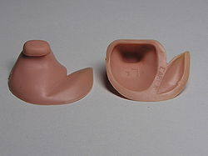
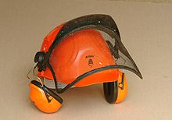
Controls at the receiver
Protection for the worker
  Earplugs
  Earmuffs
  Helmets
Not as effective as controls at the source
  Not more than 30dB
Work Systems and the Methods, Measurement, and Management of Work
by Mikell P. Groover. ISBN 0-13-140650-7
©2007 Pearson Education, Inc., Upper Saddle River, N.J. All rights reserved.

Slide 43
Climate Control
Four primary variables that define climate:
  Air temperature
  Humidity - usually relative humidity
  Air movement
  Radiation from surrounding objects, including the sun
Most comfortable working environment (called the comfort zone)
  Air temperature = 19 to 26°C (66 to 79°F)
  Relative humidity = 50%
  Slow air movement = 0.2 m/s (0.64 ft/sec)
Work Systems and the Methods, Measurement, and Management of Work
by Mikell P. Groover. ISBN 0-13-140650-7
©2007 Pearson Education, Inc., Upper Saddle River, N.J. All rights reserved.

Slide 44
Heat Balance and Thermoregulation
Ability to maintain a proper thermal balance affects the capacity of human body to perform physical work.
Normal body core temperature = 37°C (98.6 °F)
Body core temperatures above or below this value mean trouble
  Above 38°C (100°F), physiological performance is reduced
  Above 40°C (104°F), body is disabled
  Above 42°C (107°F), death likely
  Hypothermia
  Below 35°C (95°F), coordination is reduced
  Below 32°C (90°F), loss of consciousness likely
  Below 30°C (86°F), severe cardiovascular stress
Work Systems and the Methods, Measurement, and Management of Work
by Mikell P. Groover. ISBN 0-13-140650-7
©2007 Pearson Education, Inc., Upper Saddle River, N.J. All rights reserved.

Slide 45
Body’s Thermoregulation System
ΔHC = M – W – E ± R ± C
where
  ΔHC = net change in heat content in the body
  M = metabolic energy produced
  W = work performed by the body
  E = heat lost through perspiration and evaporation
  R = radiant heat loss or gain
  C = heat loss or gain through convection
Work Systems and the Methods, Measurement, and Management of Work
by Mikell P. Groover. ISBN 0-13-140650-7
©2007 Pearson Education, Inc., Upper Saddle River, N.J. All rights reserved.

Slide 46
Regulating Body Temperature
Automatic body mechanisms
  Sweating
  Shivering
  Constricting or dilating blood vessels
Conscious actions
  Clothing
  Sun / shade
  Exercising
Work Systems and the Methods, Measurement, and Management of Work
by Mikell P. Groover. ISBN 0-13-140650-7
©2007 Pearson Education, Inc., Upper Saddle River, N.J. All rights reserved.

Slide 47
Heat Stress
Occurs when body absorbs more heat than it gives off, raising the body core temperature (high temperature, high humidity, high radiated heat, high physical activity)
Illnesses resulting from heat stress:
  Heat rash - areas of skin erupt into red or white bumps due to inflammation of sweat glands
  Heat cramps - spasms of muscles in physical labor (loss of salt)
  Heat exhaustion - muscle weakness, nausea, dizziness (loss of salt)
  Heatstroke - fever, dry skin, convulsions, coma (in extreme cases: death)
Work Systems and the Methods, Measurement, and Management of Work
by Mikell P. Groover. ISBN 0-13-140650-7
©2007 Pearson Education, Inc., Upper Saddle River, N.J. All rights reserved.

Slide 48
Work in Which Heat Stress Occurs
Foundries (metal casting)
Boiler operations (steam and power generation)
Basic metals industries (e.g., iron- and steel-making, aluminum production)
Hot working of metals (e.g., hot forging)
Heat treatment of metals and glasses
Outdoor construction in summertime
Agricultural work in summertime
Landscaping in summertime
Work Systems and the Methods, Measurement, and Management of Work
by Mikell P. Groover. ISBN 0-13-140650-7
©2007 Pearson Education, Inc., Upper Saddle River, N.J. All rights reserved.

Slide 49
Reducing Heat Stress
Administrative controls:
  Provide water for workers
  Frequent rest breaks
  Limit times in hot environment
  Work in the shade, and in the early hours
Engineering controls:
  Provide air conditioning if feasible
  Provide fans
  Shield radiant heat sources
  Wear protective clothing
Work Systems and the Methods, Measurement, and Management of Work
by Mikell P. Groover. ISBN 0-13-140650-7
©2007 Pearson Education, Inc., Upper Saddle River, N.J. All rights reserved.

Slide 50
Cold Stress
Drop in core body temperature below normal due to net heat loss from combination of low temperature and air movement
Windchill factor - estimates cooling effect of moving air on exposed skin
Jobs where cold stress is a problem:
  Refrigerated warehouses
  Construction jobs in wintertime
  Aboard ships in extreme northern climates
  Research in the cold zones
Work Systems and the Methods, Measurement, and Management of Work
by Mikell P. Groover. ISBN 0-13-140650-7
©2007 Pearson Education, Inc., Upper Saddle River, N.J. All rights reserved.

Slide 51
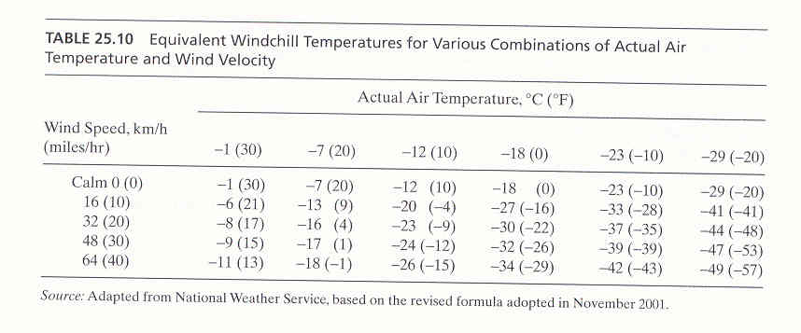
Work Systems and the Methods, Measurement, and Management of Work
by Mikell P. Groover. ISBN 0-13-140650-7
©2007 Pearson Education, Inc., Upper Saddle River, N.J. All rights reserved.

Slide 52
Body Reactions to Cold Stress
Vasoconstriction - narrowing of blood vessels in the skin (especially in fingers and toes) to keep warm blood away from areas exposed to cold
Shivering - rapid quivering or shaking of the muscles, which generates heat by increasing metabolism
Work Systems and the Methods, Measurement, and Management of Work
by Mikell P. Groover. ISBN 0-13-140650-7
©2007 Pearson Education, Inc., Upper Saddle River, N.J. All rights reserved.

Slide 53
Effects of Cold Environments
Frostbite - tissue freezes and ice crystals form in tissue cells → gangrene in extreem cases
  Commonly occurs in hands and feet (in 15 min. or less with windchill values of -28 °C or lower)
Hypothermia - when body core temperature is at or below 35°C (95°F) (diminishes physical and mental capacity)
Work Systems and the Methods, Measurement, and Management of Work
by Mikell P. Groover. ISBN 0-13-140650-7
©2007 Pearson Education, Inc., Upper Saddle River, N.J. All rights reserved.

Slide 54
Reducing Cold Stress
Administrative controls:
  Limit work times in cold environment
  Allow frequent breaks to warm hands
  Drink hot beverages
Engineering controls:
  Proper clothing (layering principle - multiple layers of clothing more essential than the fabric)
  Provide gloves
  Provide space heaters when building is cold
Work Systems and the Methods, Measurement, and Management of Work
by Mikell P. Groover. ISBN 0-13-140650-7
©2007 Pearson Education, Inc., Upper Saddle River, N.J. All rights reserved.

